Slide 1
LEADERSHIP TODAY
WBro David Freeman
RWBro Larry Lee Atkinson

Slide 2
Leadership Today
A man’s character is his fate…and the destiny of the led is bound to the leader.
Heraclitus

Slide 3
Leadership Today
Leaders are not born; they are made.
Leadership is not a natural trait; something inherited like the color of eyes or hair. Actually, leadership is a skill that can be studied, learned and perfected by practice.
FM6 – 22 US Army

Slide 4
Leadership Today
Definition of Leadership
Leadership is influencing people, by providing purpose, direction and motivation, while operating to accomplish the mission and improving the organization

Slide 5
Leadership Today
Definition of influencing
A means of getting people to do what you want them to do to achieve two ends: operating and improving
The example you set is just as important as the words you speak
Your words and example must communicate purpose, direction and motivation

Slide 6
Leadership Today
Styles of Leadership
Authoritarian or Autocratic
I want you to do this…
Participative or Democratic
Let’s work together to solve this…
Delagative or Free reign
You take care of this while I…
Paternalism
Supply needs or regulate conduct of Members

Slide 7
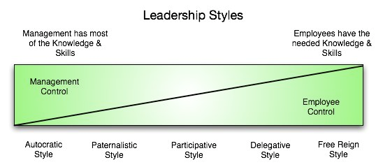
Leadership Today

Slide 8
Leadership Today
Authoritarian or Autocratic
Leaders tell Members what they want done and how to do it
Most effective when you have all the information and your Members are well motivated
This is not ‘bossing people around’ or ‘yelling at them’(unprofessional)
Used on new Members

Slide 9
Leadership Today
Participative or Democratic
Members are included in the decision making process(determine what to do and how to do it)
Leaders employ knowledgeable and skilful people
Best used to develop teams and teamwork

Slide 10
Leadership Today
Delegative or Free Reign
Leaders allow Members to make decisions
Members know what is to be done and how to do it
Authority is delegated
Leaders trust and respect Members
Used when Members know more than you

Slide 11
Leadership Today
Paternalism
A system under which authority undertakes to supply needs or regulate conduct of those under its control in matters affecting them as individuals as well as in their relationships to authority and to each other

Slide 12
Leadership Today
Who is a leader?
Anyone who by virtue of assumed role or assigned responsibility inspires and influences people to accomplish organizational goals

Slide 13
Leadership Today
Our Core Values
Loyalty
Your Obligations, Oath of Office at Installation
Duty
Consistently strive to do the very best
Respect
Treat people as they should be treated

Slide 14
Leadership Today
Our Core Values
Service to the Order
Put the welfare of the Lodge before your own
Honor
The moral compass for character and conduct
Integrity
Do what is right; legally and morally
Personal Courage
To stand alone

Slide 15
Leadership Today
Core Leader Competencies
Leads
Leads others, Leads by example
Communicates with others
Develops
Creates pos environment, Prepares self
Develops others
Achieves
Gets results

Slide 16
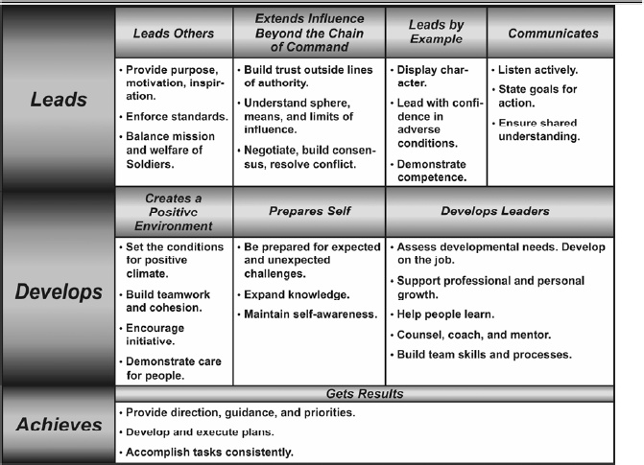
Leadership Today

Slide 17
Leadership Today
Leadership w/o authority
Responsible Members take charge to complete a task
Expertise in a technical area
Member takes initiative to alert Leadership of potential problems or predict consequences

Slide 18
Leadership Today
Empowering Members
Give a task
Delegate authority
Let Member do the work
Remember, no leader is irreplaceable

Slide 19
Leadership Today
Be – Know – Do
Be values and attributes
Know skills
Do leadership actions

